Slide 1
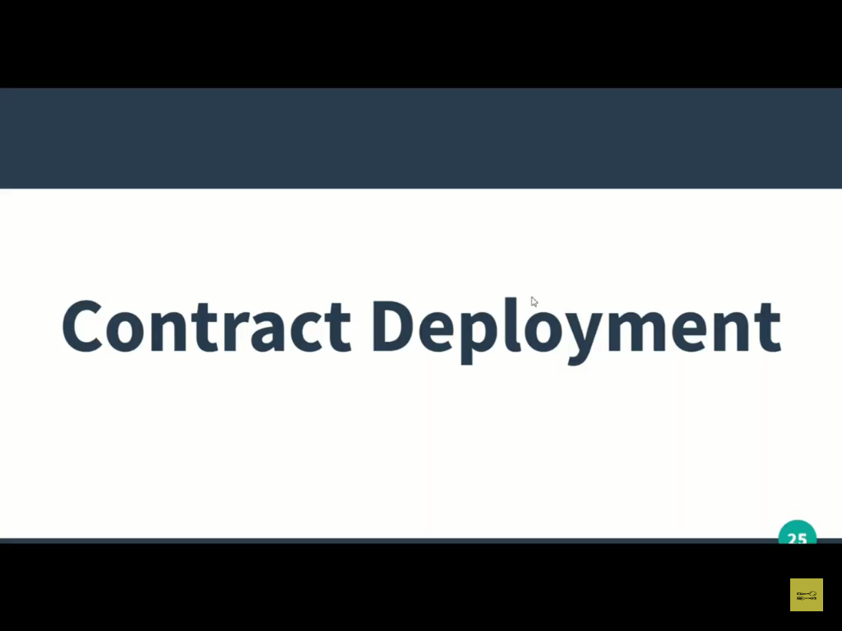

Slide 2
Remix IDE provides some enviroment where we can deploy our smart contract.

Slide 3
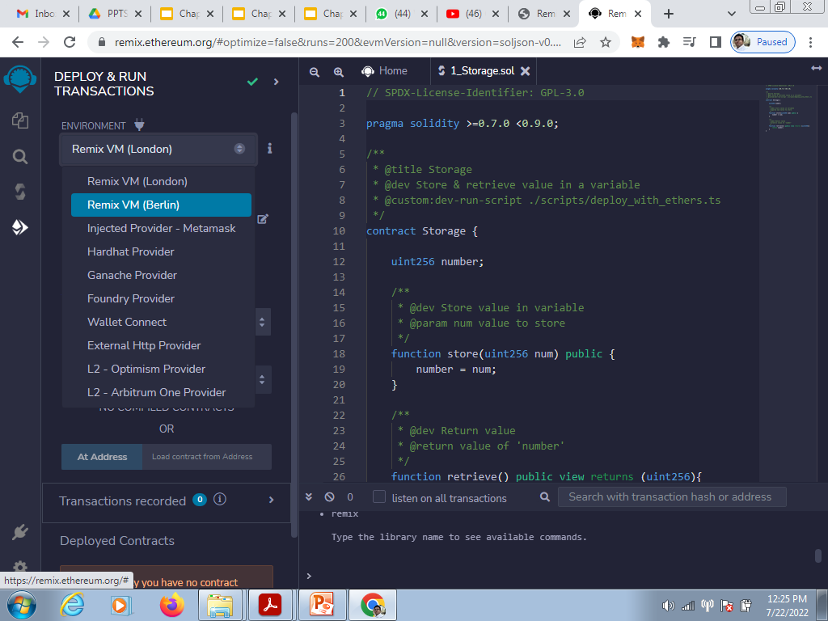

Slide 4
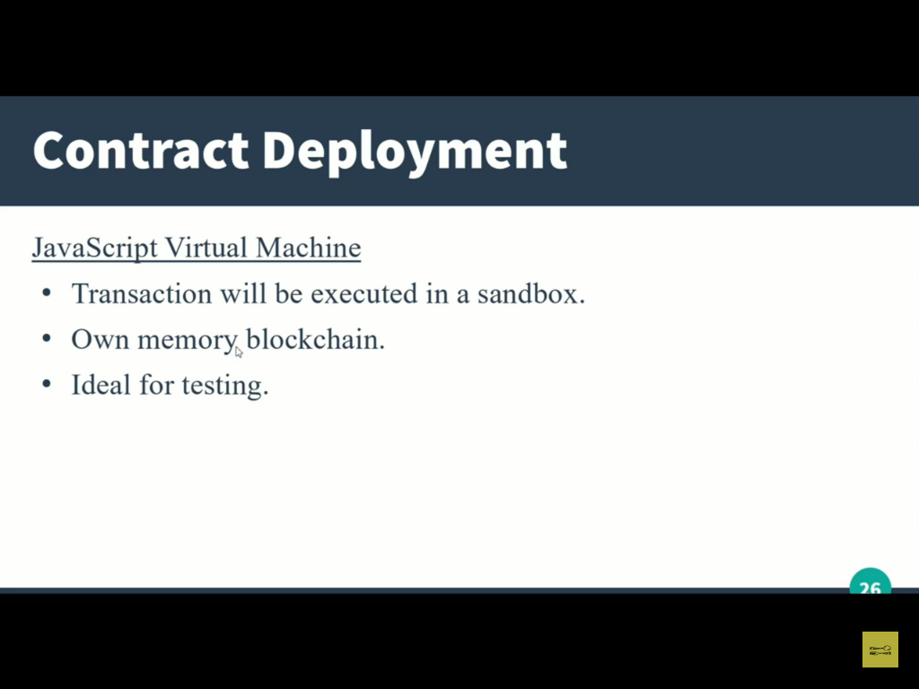

Slide 5
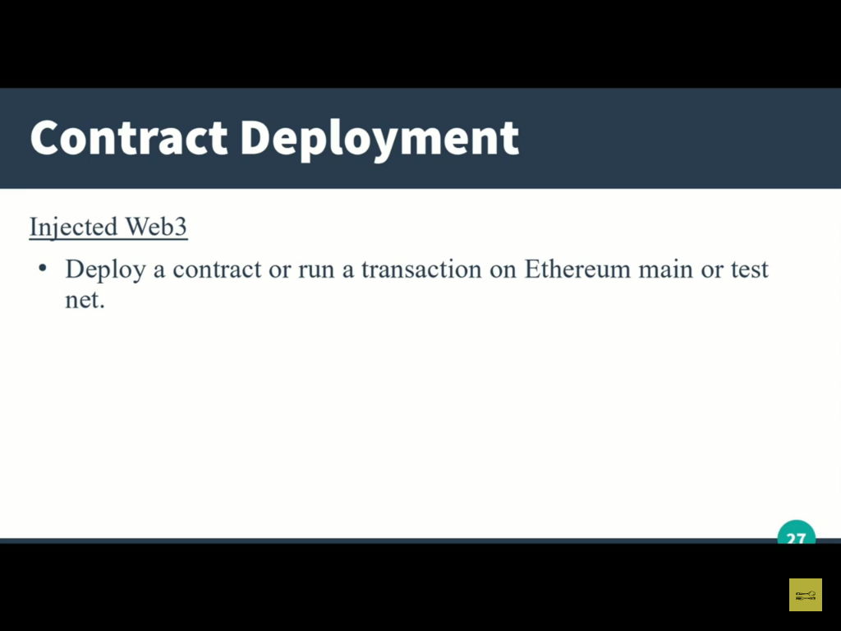

Slide 6
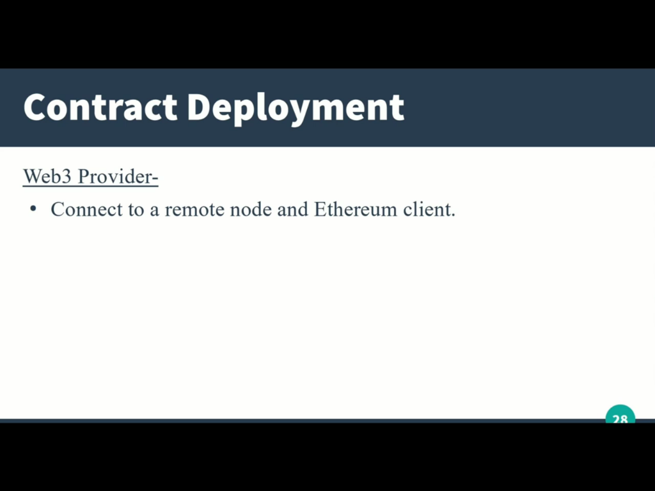

Slide 7
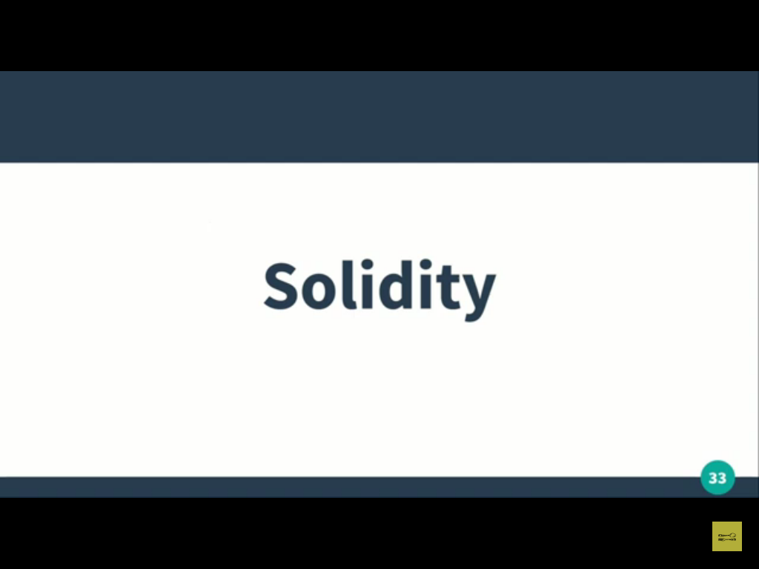

Slide 8
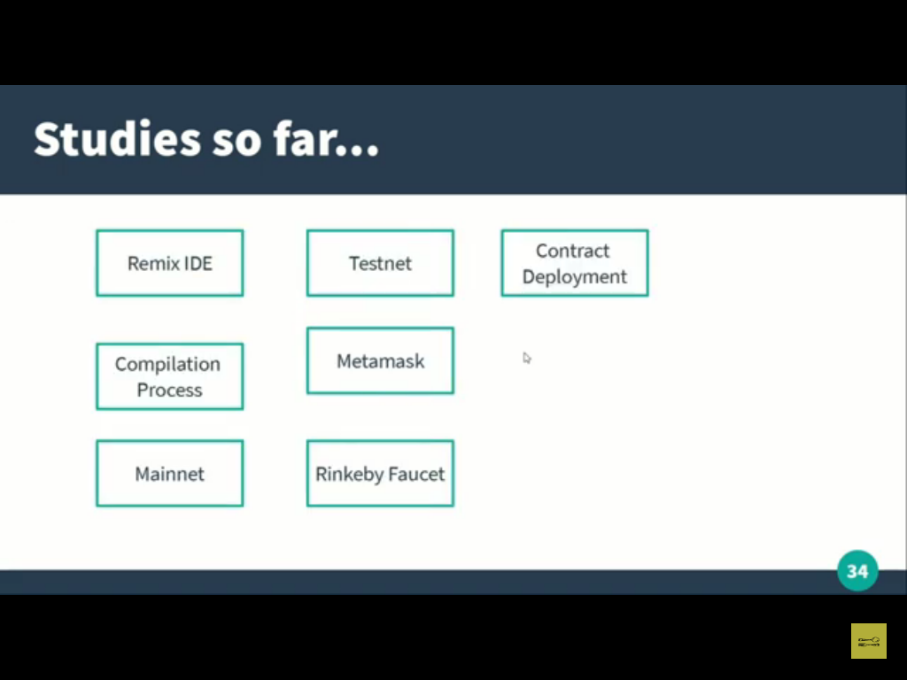

Slide 9
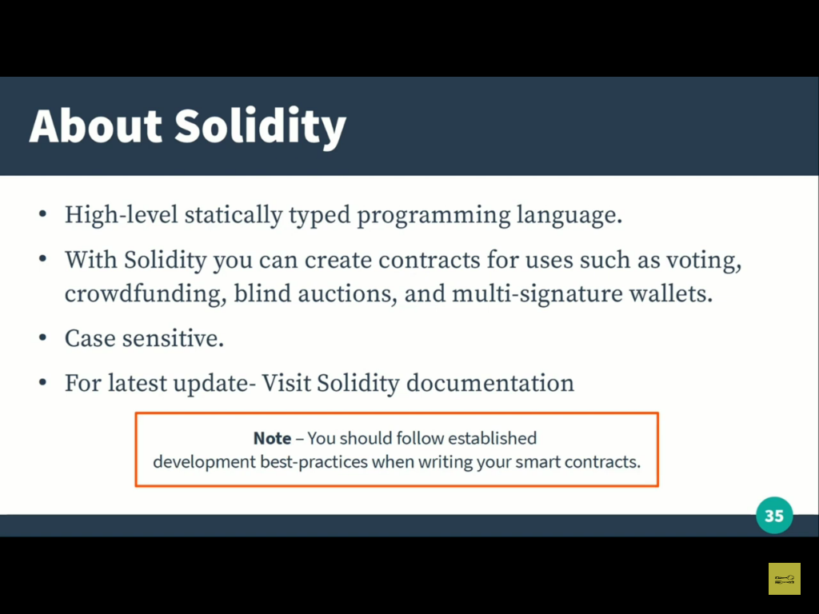

Slide 10
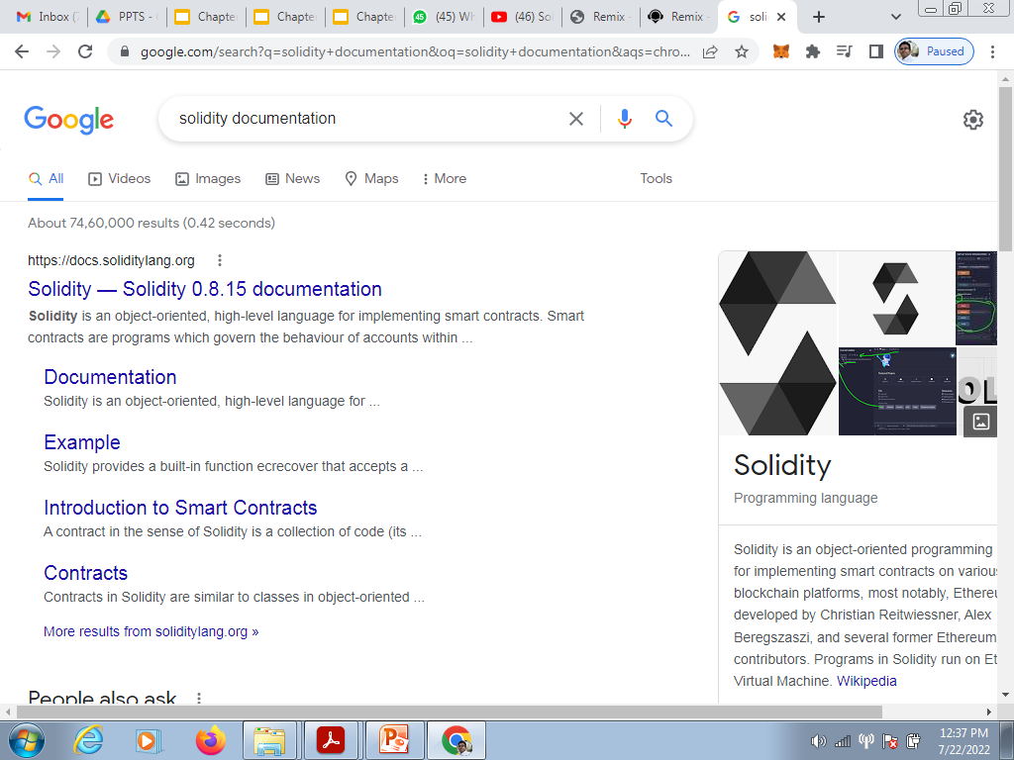

Slide 11
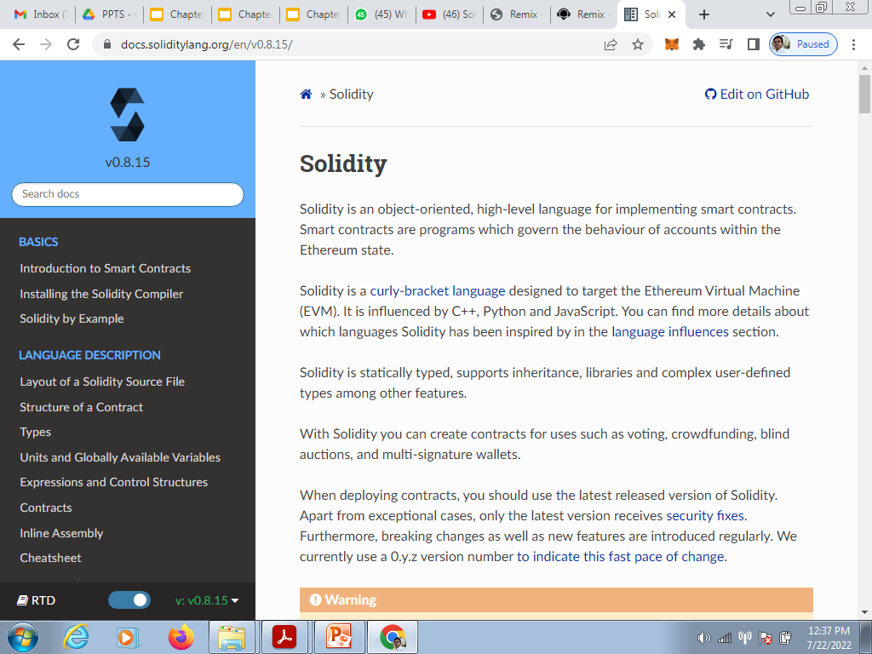

Slide 12
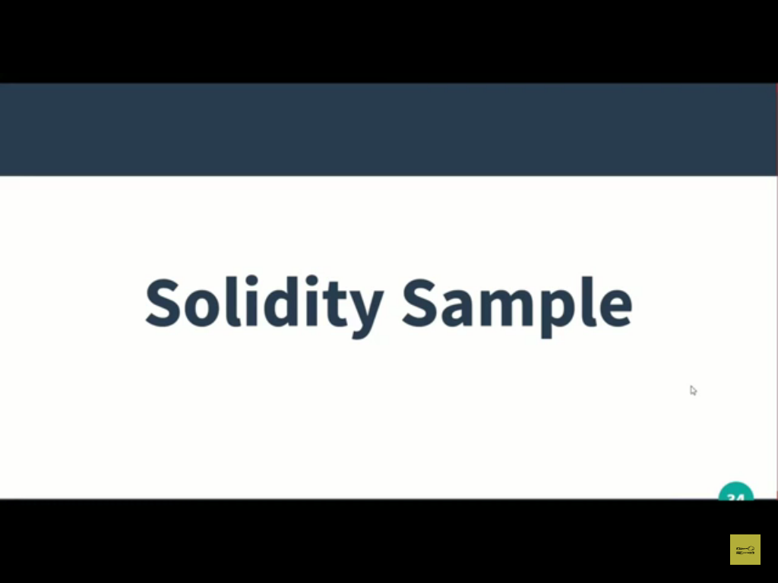

Slide 13
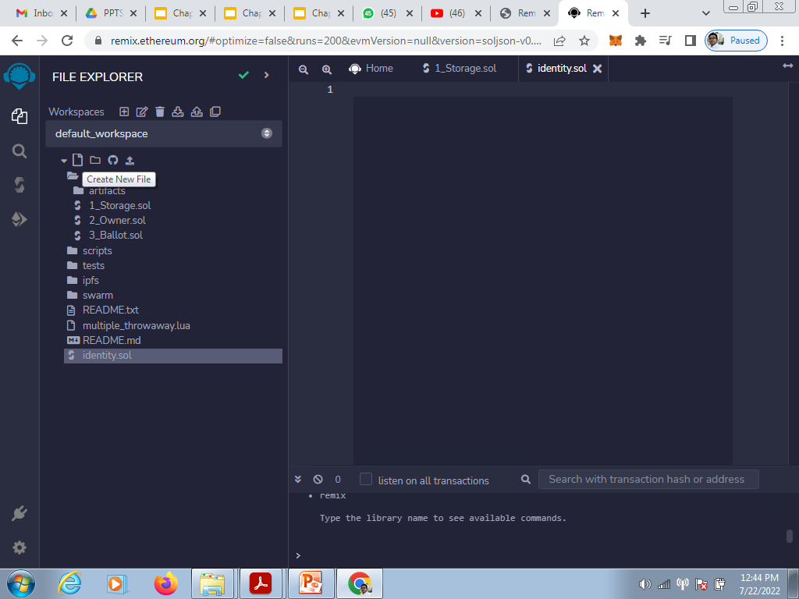

Slide 14
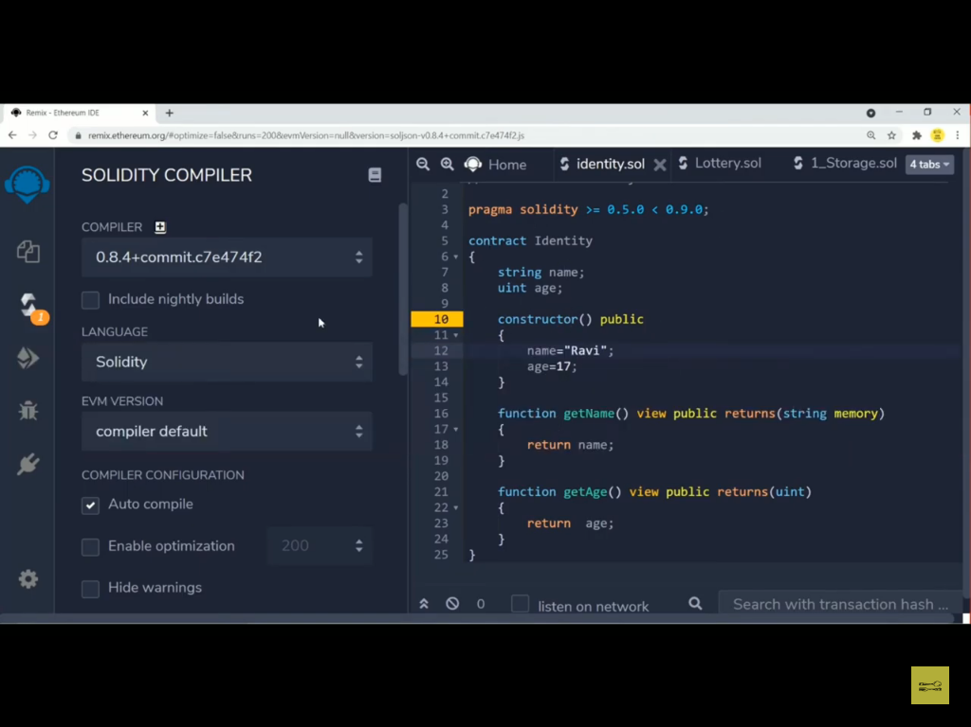

Slide 15
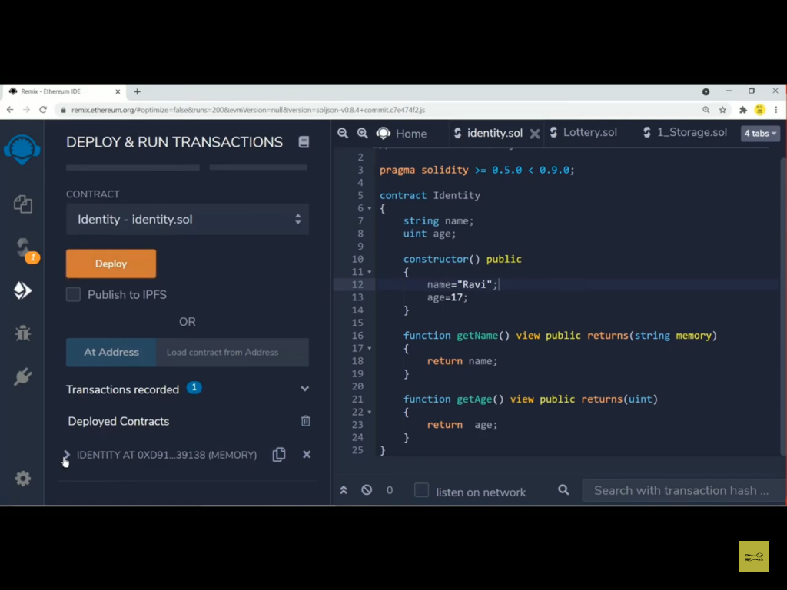

Slide 16
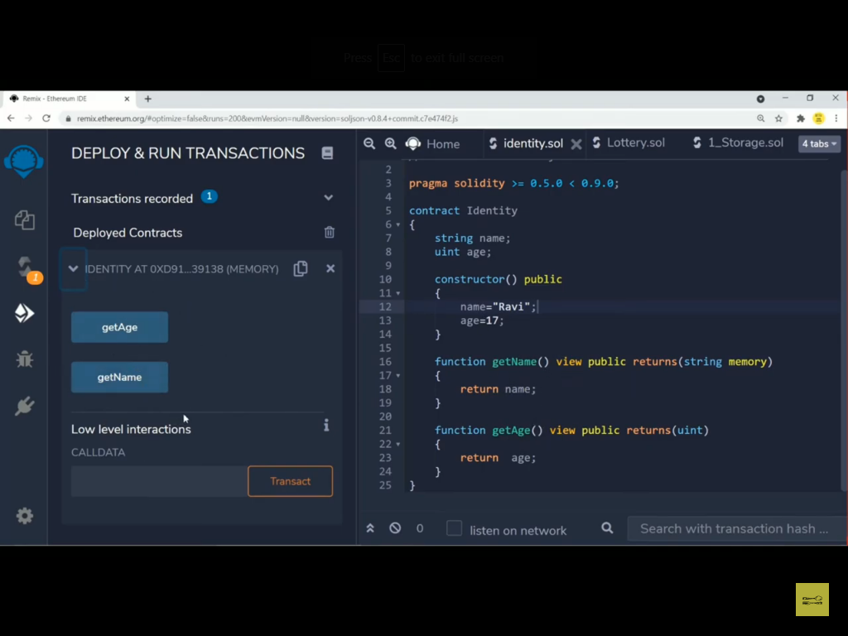

Slide 17
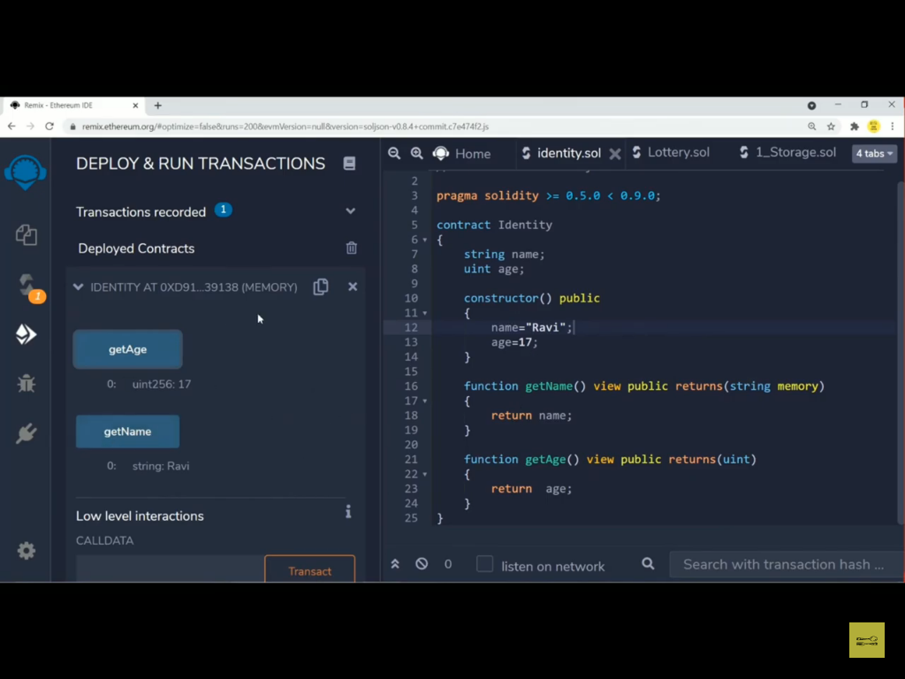

Slide 18
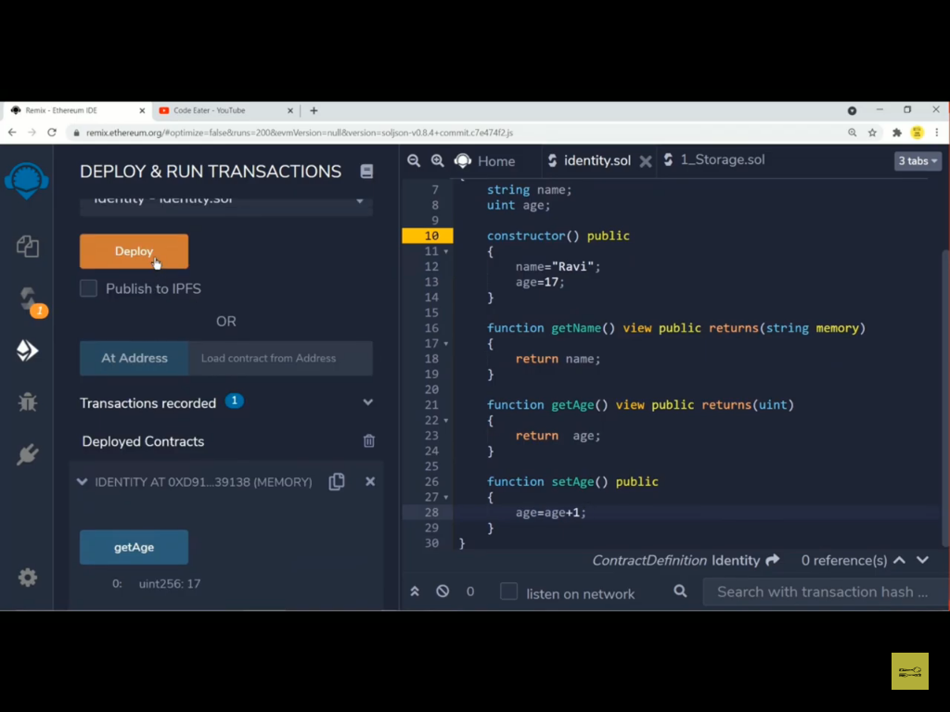

Slide 19
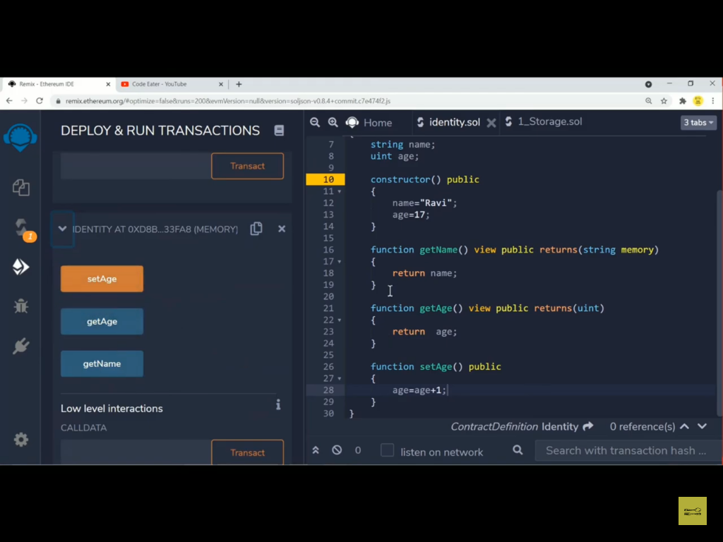

Slide 20
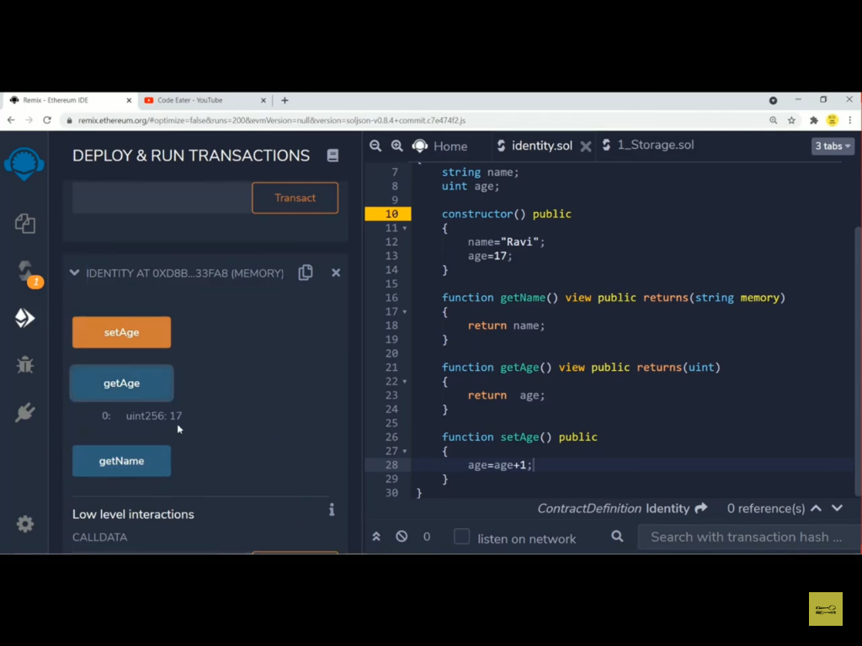

Slide 21


Slide 22


Slide 23
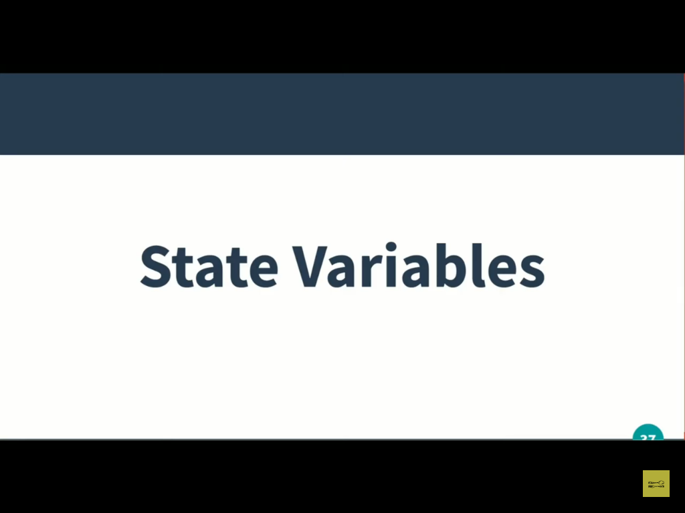

Slide 24
State Variable
The state variable stored in blockchain at contract level.
The variable declared at contract level is called as state variable.
If you increase the number of state variables the amount of gas fees is also increases.
So we need to declare the state variable carefully.
There is no concept of null(ex-c language) or none(ex-python langauge) in solidity.
The default value of the respective datatype will be stored in state variable.

Slide 25
When we write public before any variable that time get function will be created for that variable or function.
If we set the auto compilation then there is no need to compile the code every time.
We can directly deploy.
We can not assign any value to state variable directly.
We can create a constructor to assign the value or we can create a setter function.

Slide 26
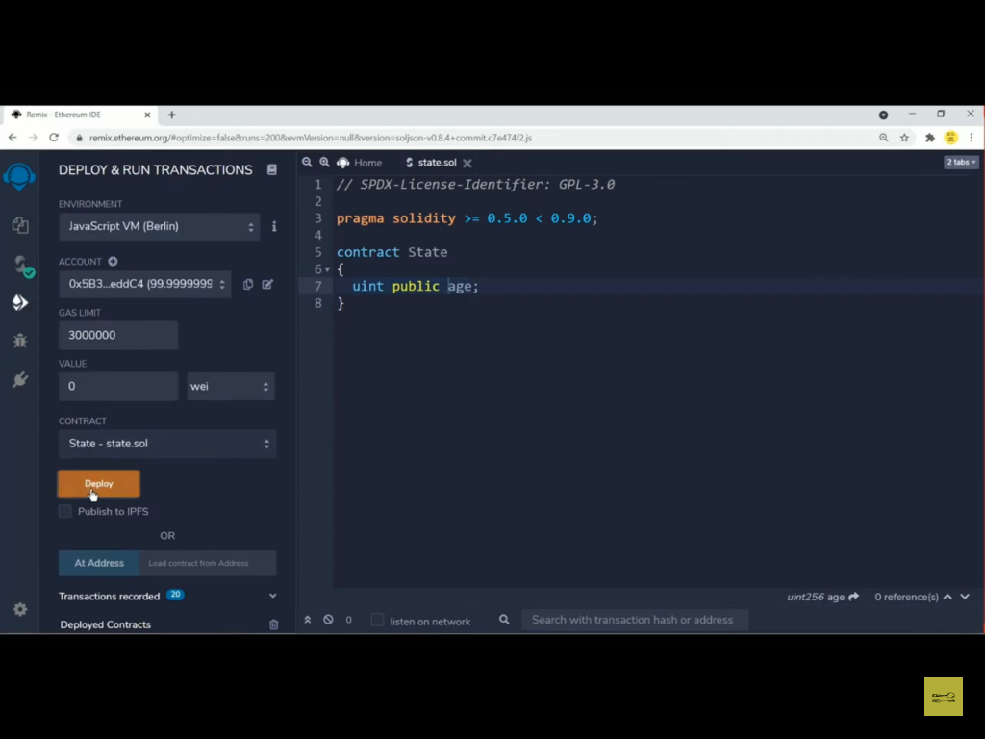

Slide 27
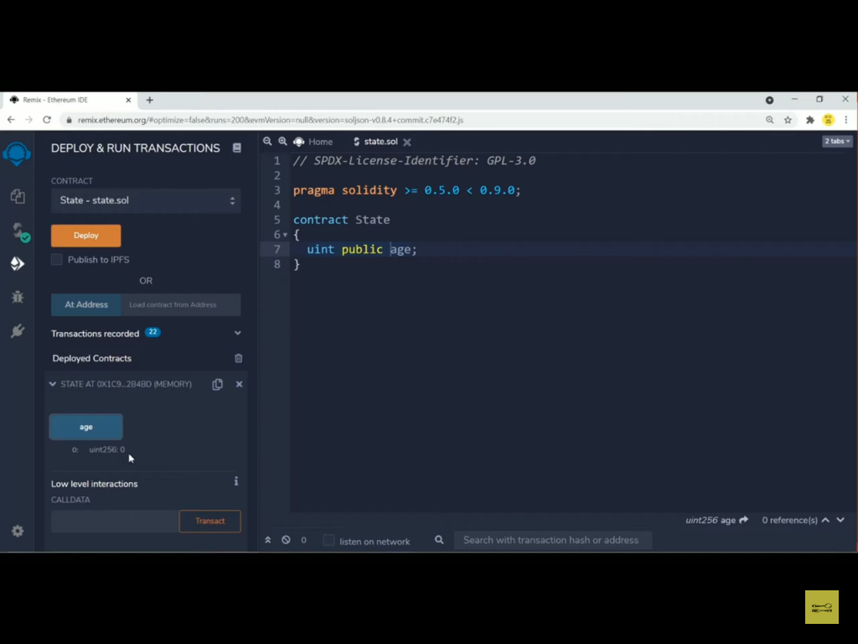

Slide 28
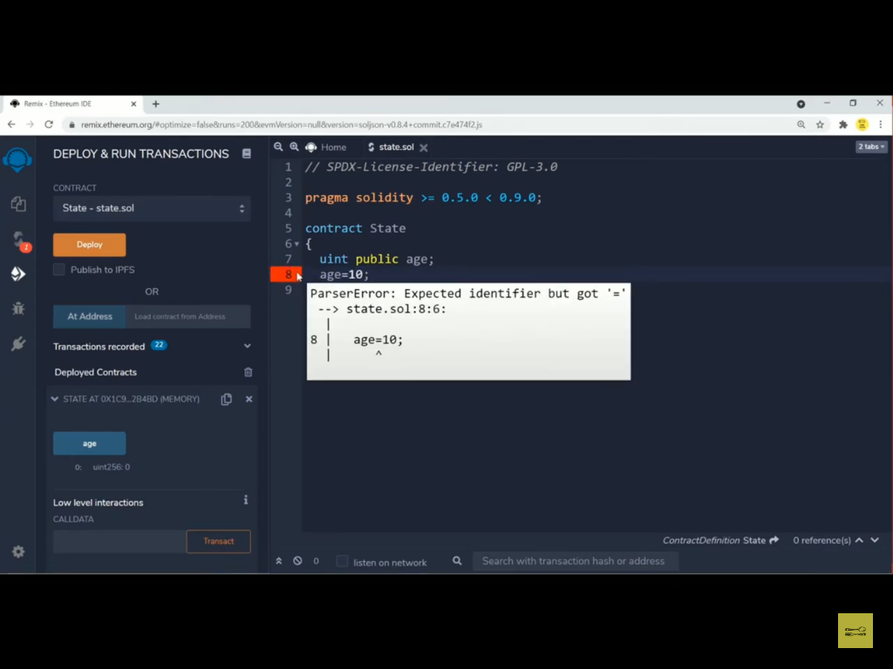

Slide 29
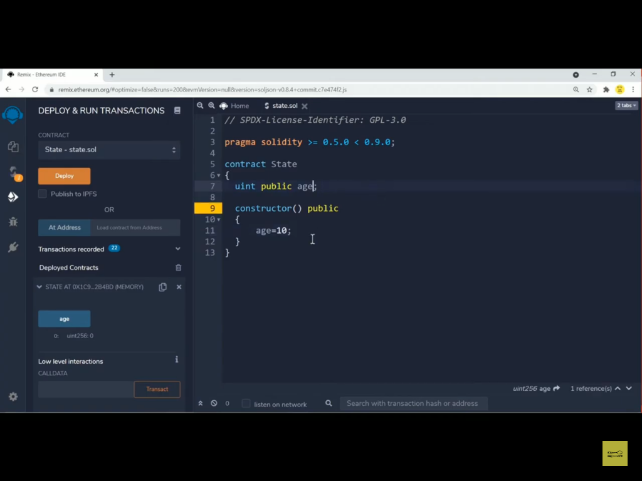

Slide 30
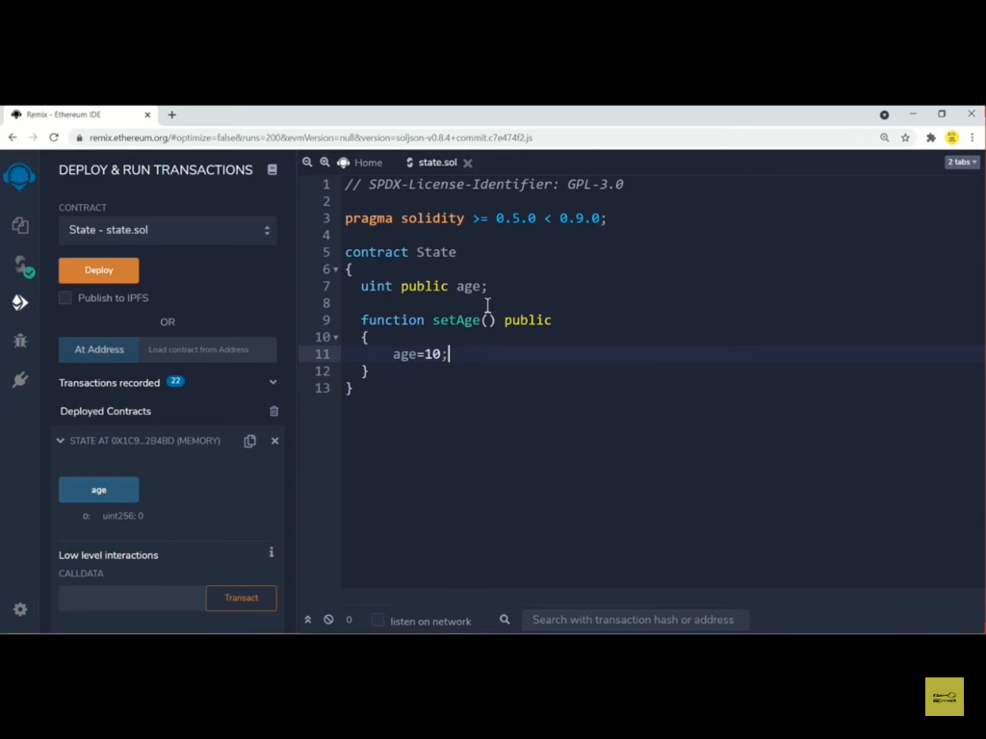

Slide 31
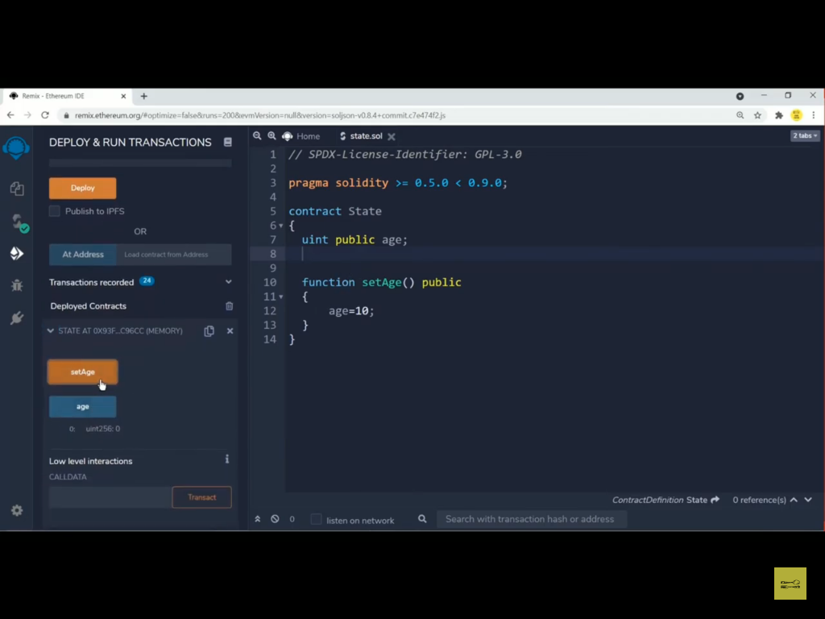

Slide 32


Slide 33
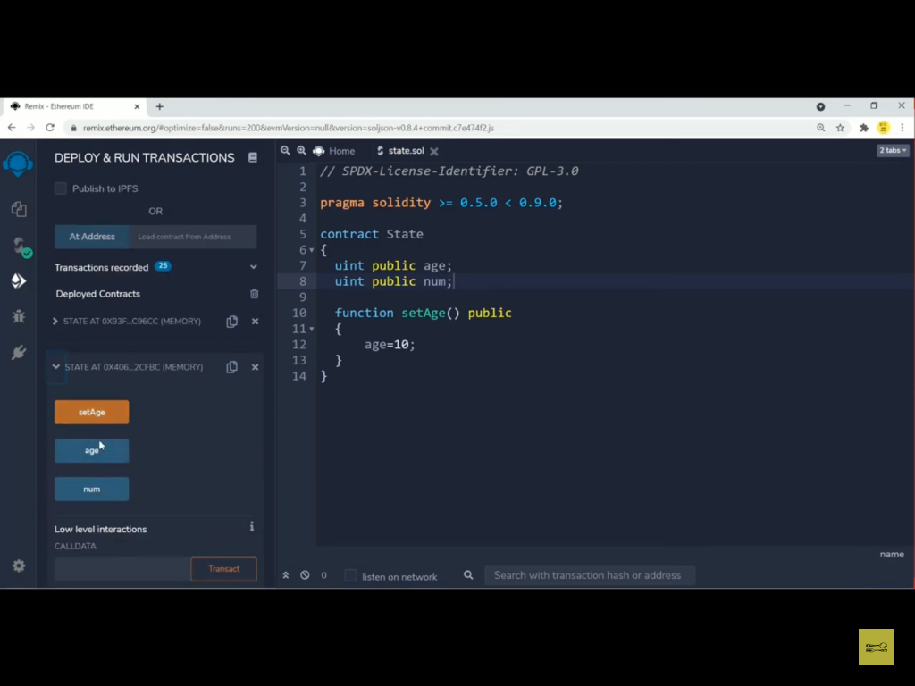

Slide 34
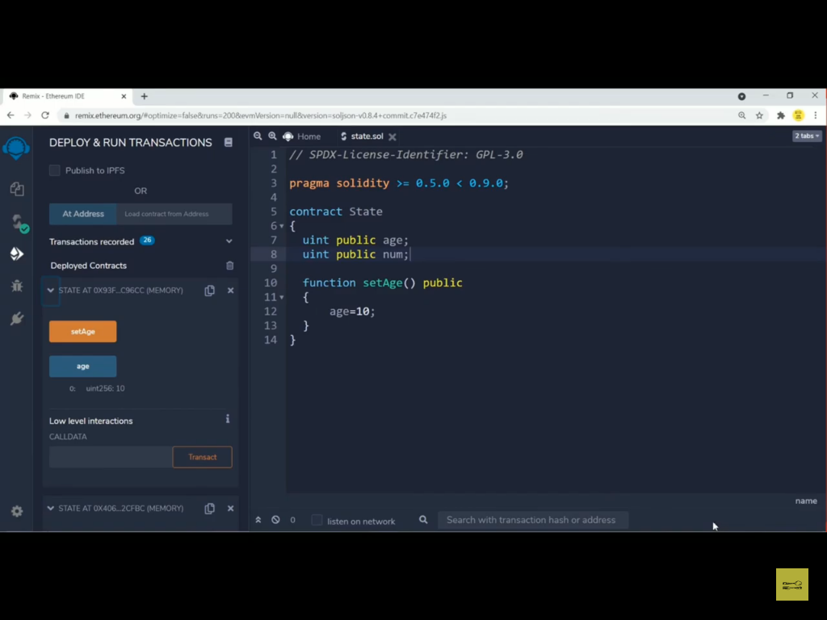

Slide 35
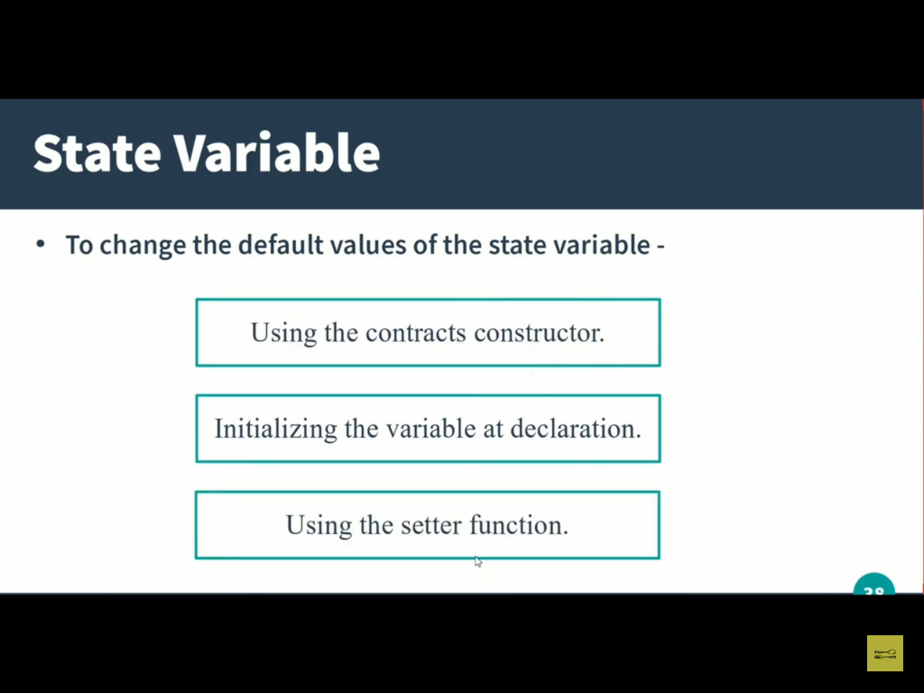

Slide 36
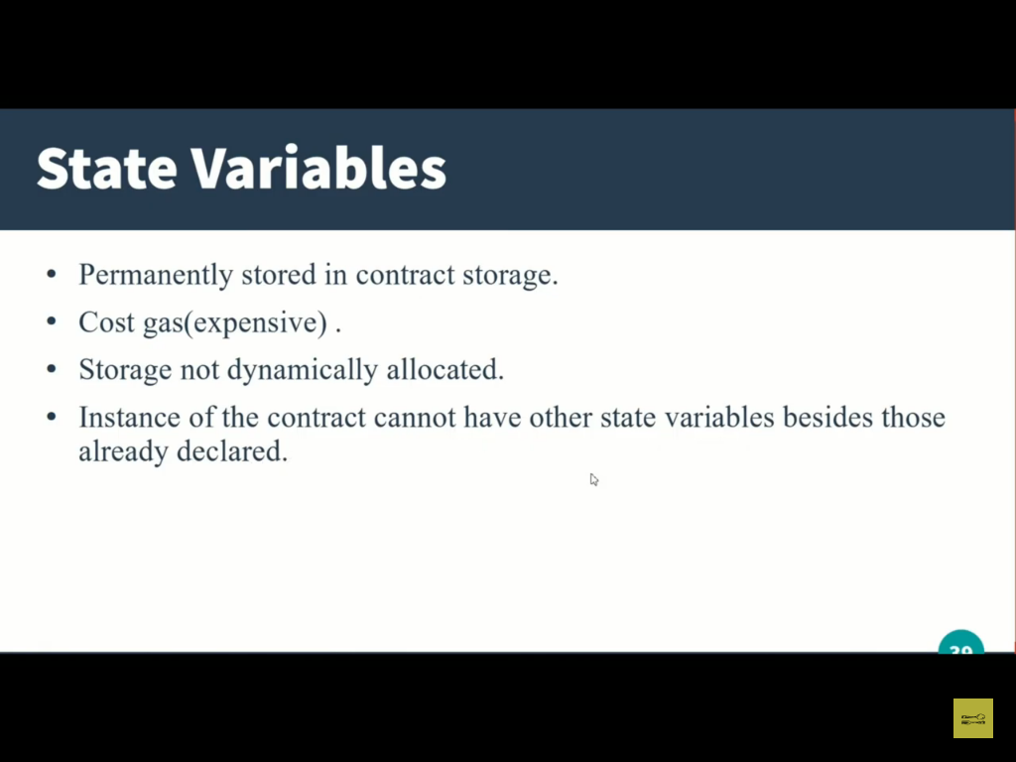

Slide 37
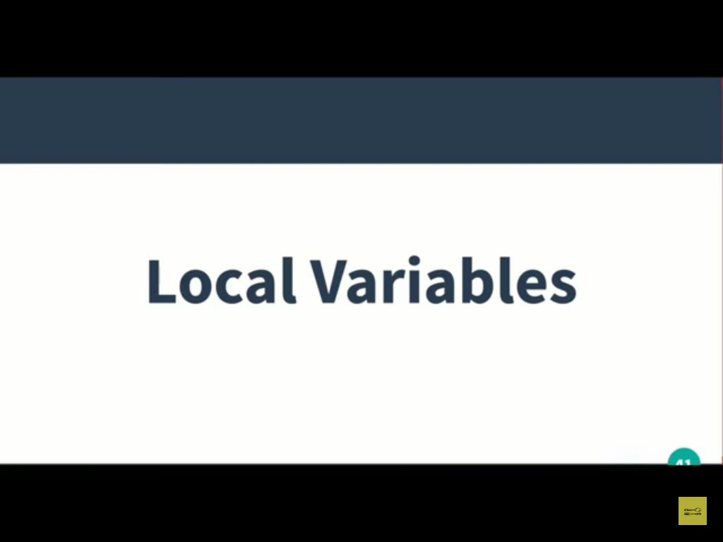

Slide 38
Local variable stored in stack unlike the state variable which stores in contract level.

Slide 39
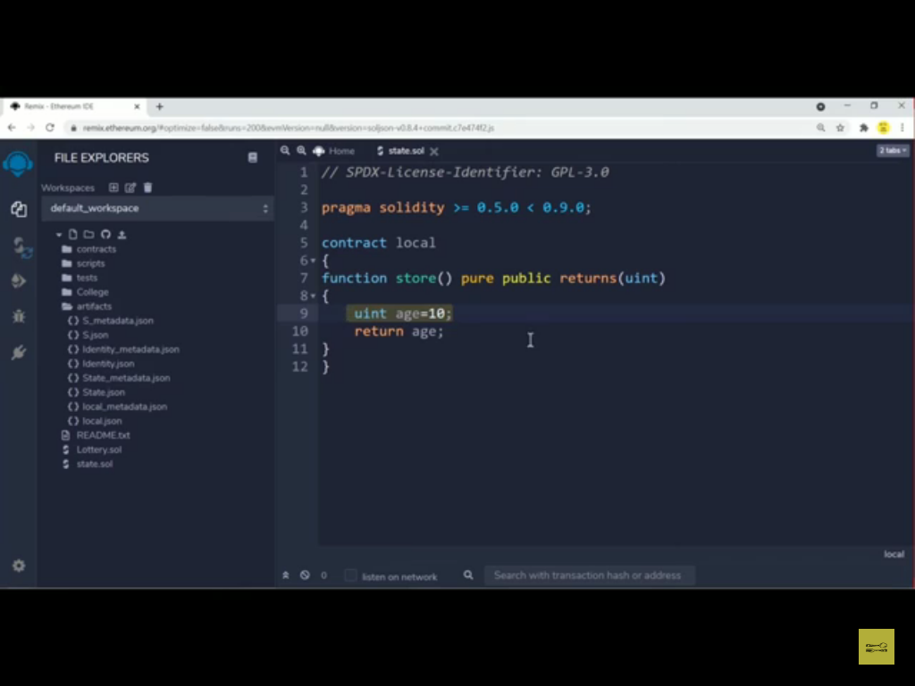

Slide 40
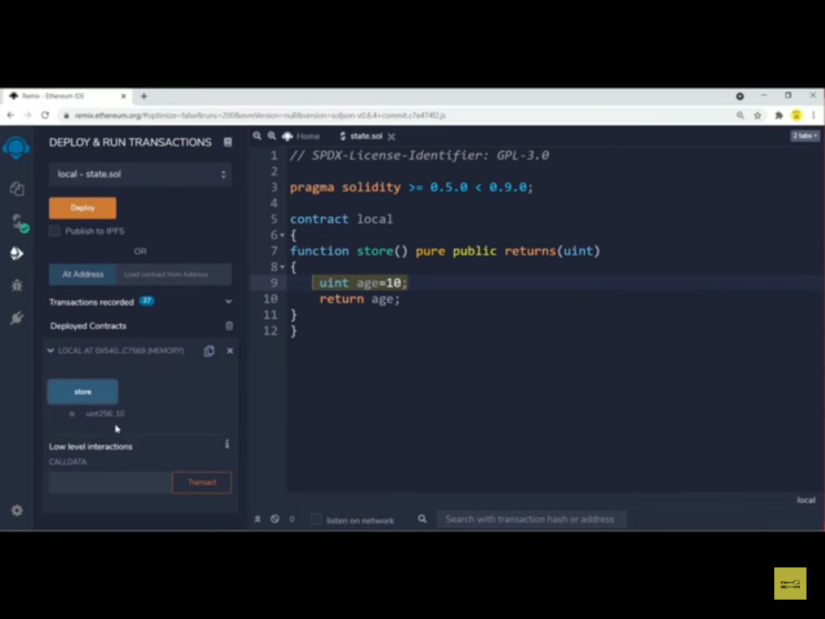

Slide 41
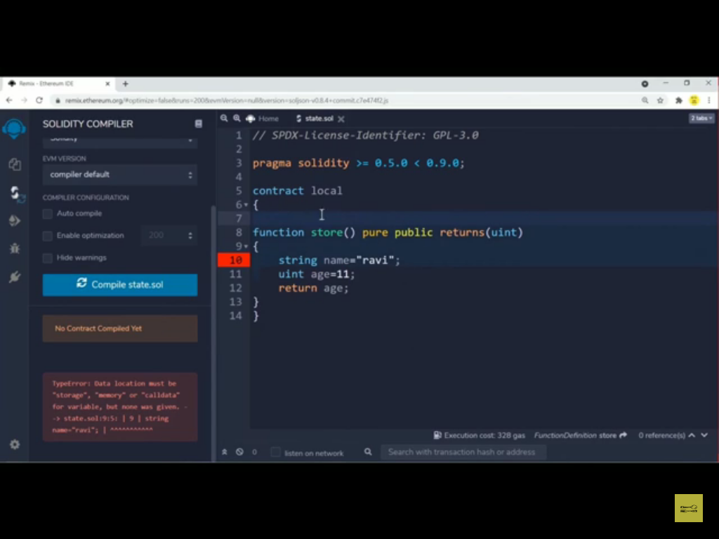

Slide 42
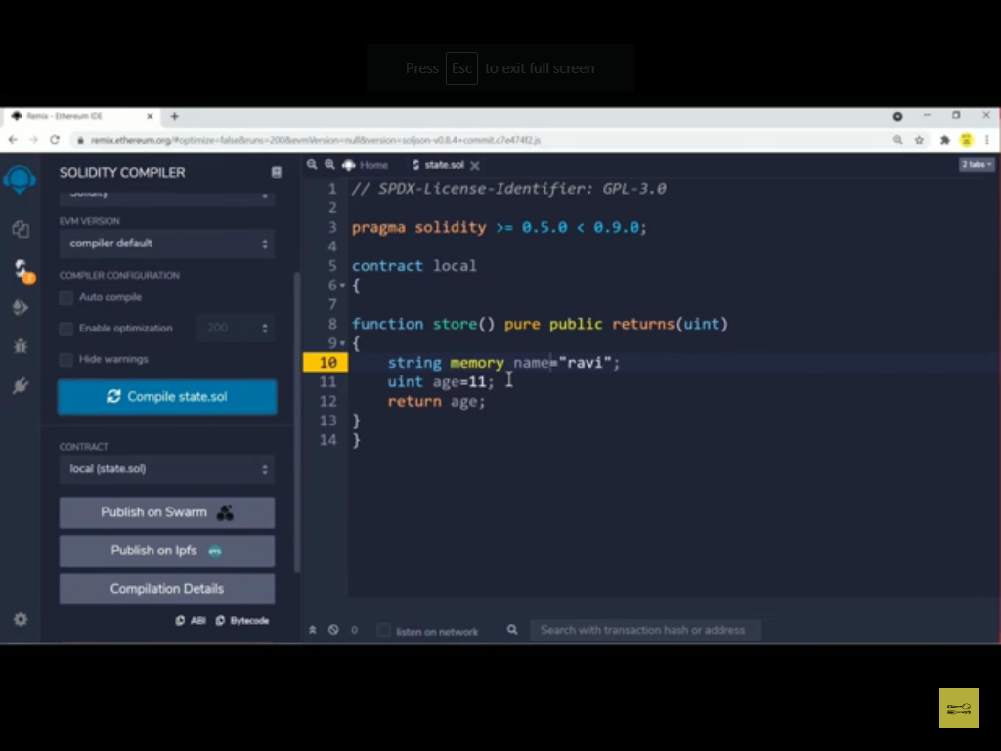

Slide 43
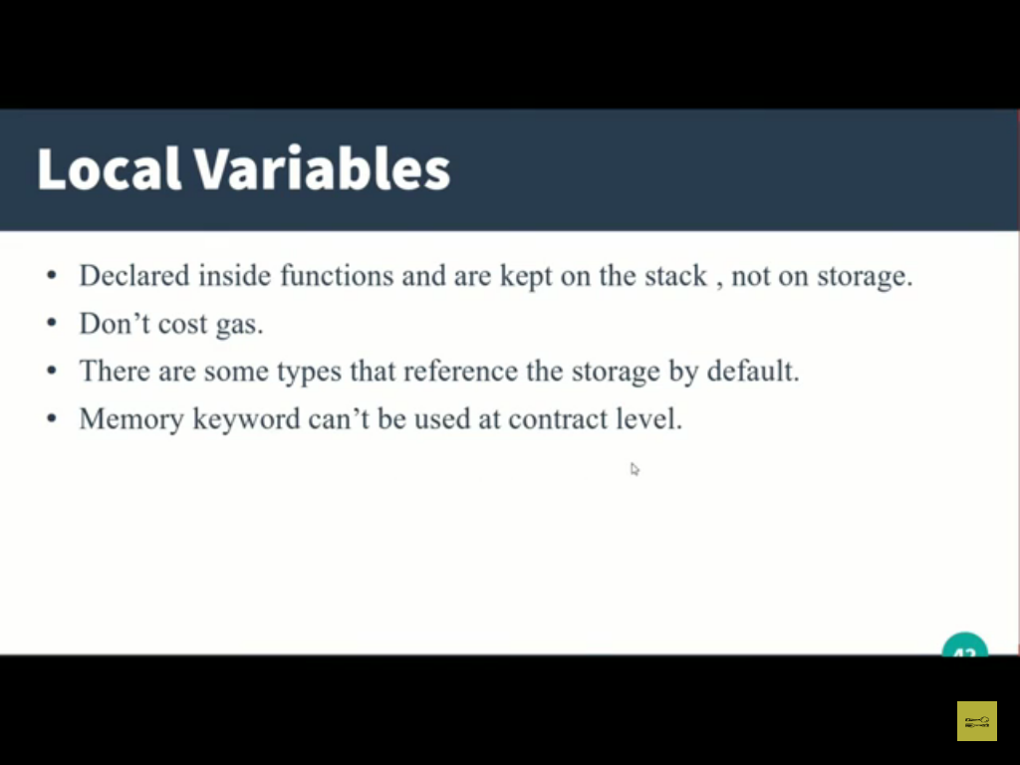

Slide 44
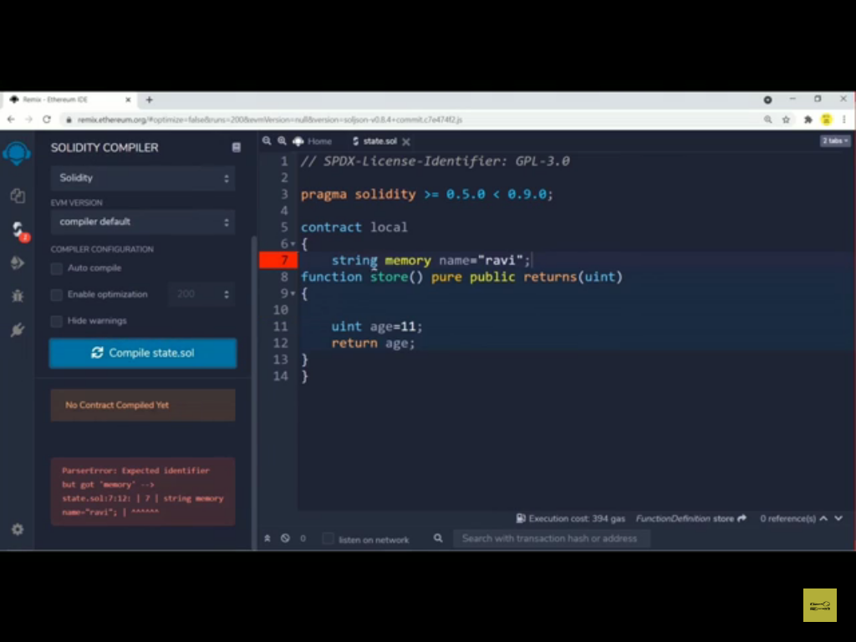

Slide 45
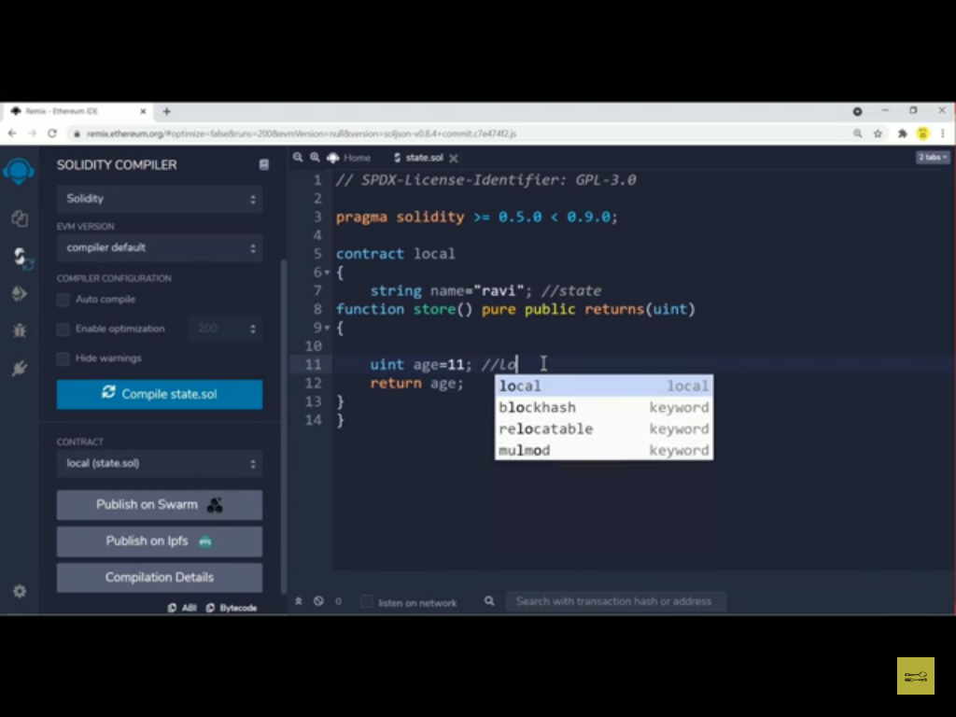

Slide 46
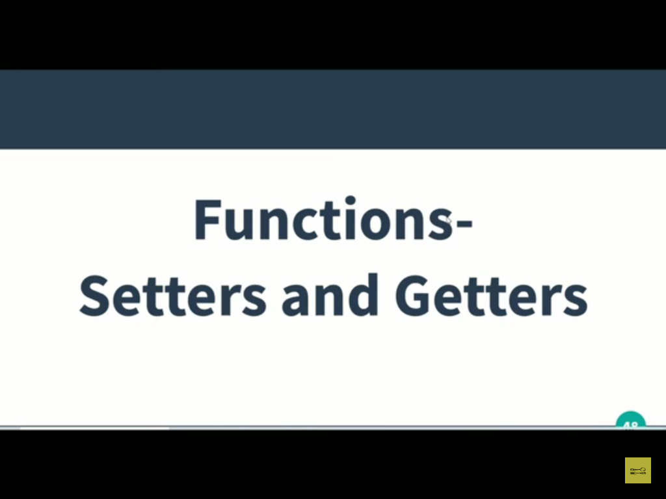

Slide 47
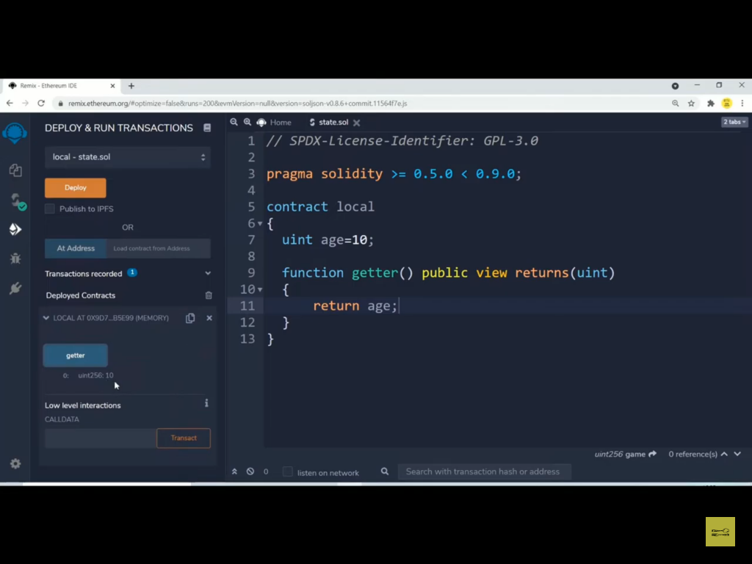

Slide 48
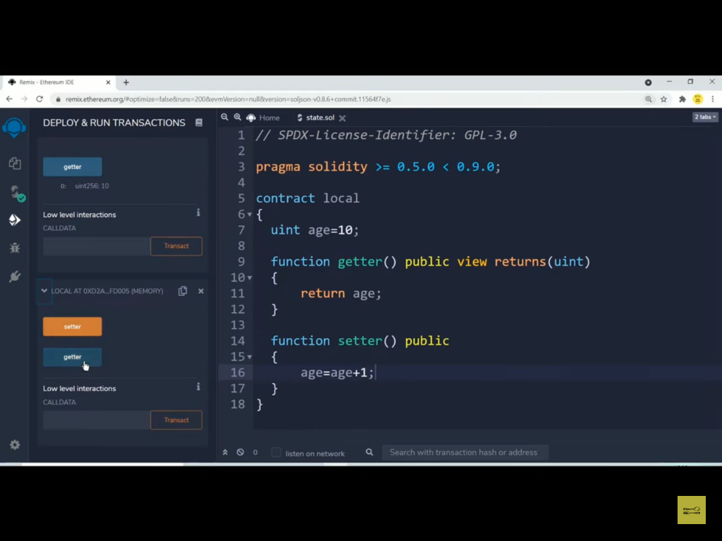

Slide 49
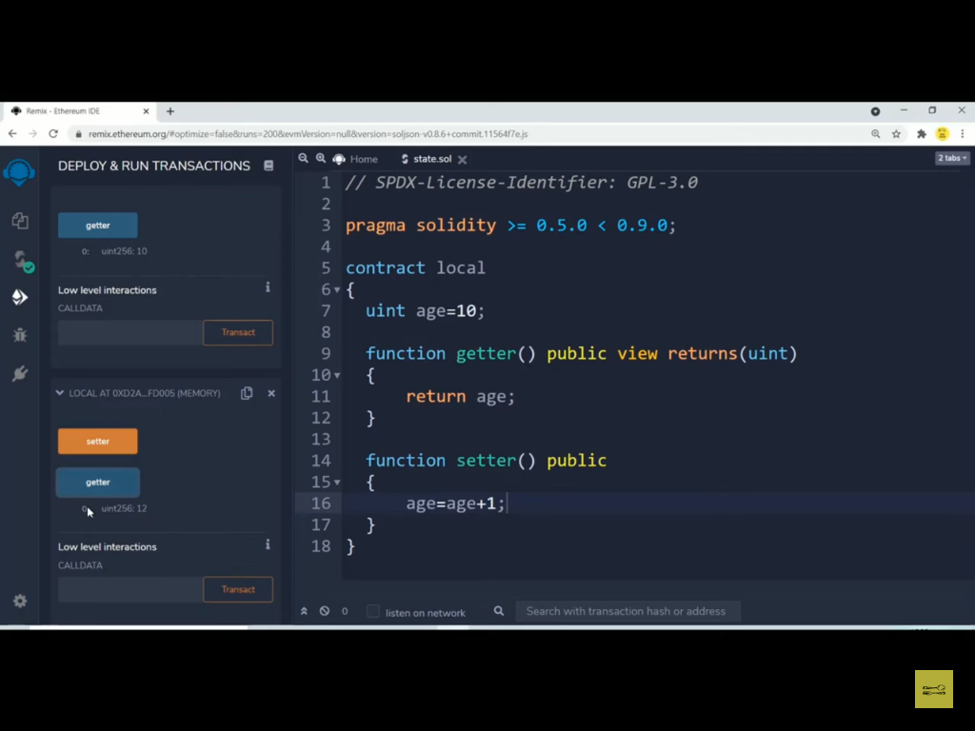

Slide 50
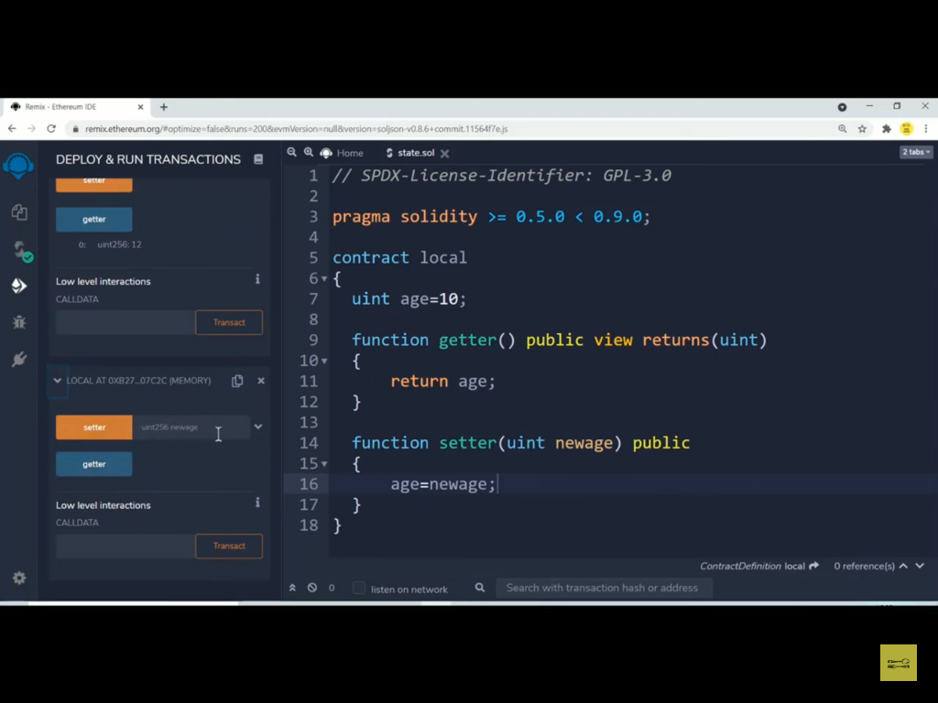

Slide 51
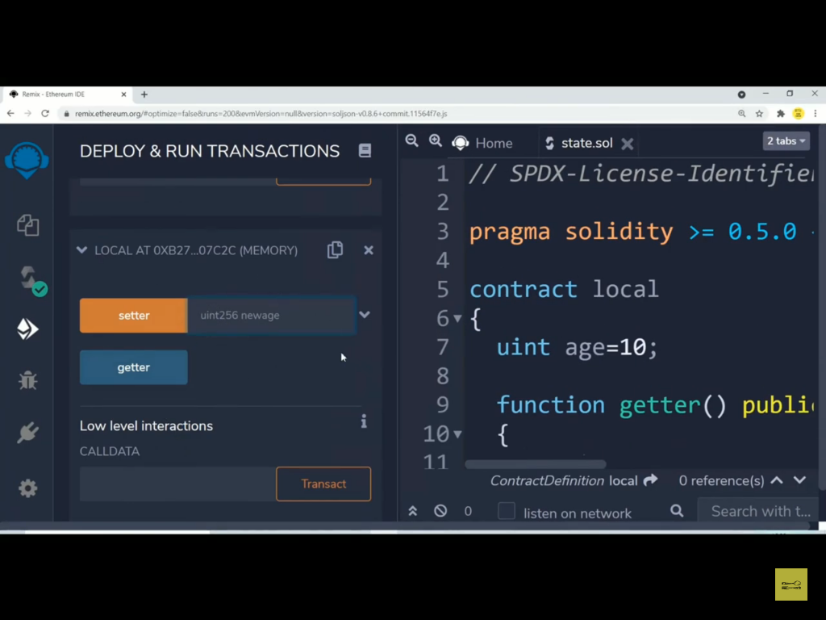

Slide 52
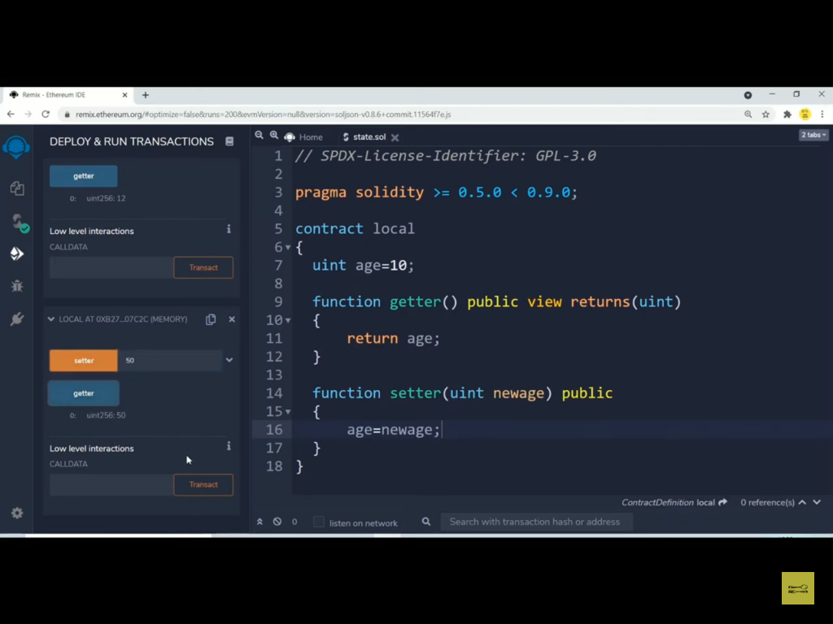

Slide 53
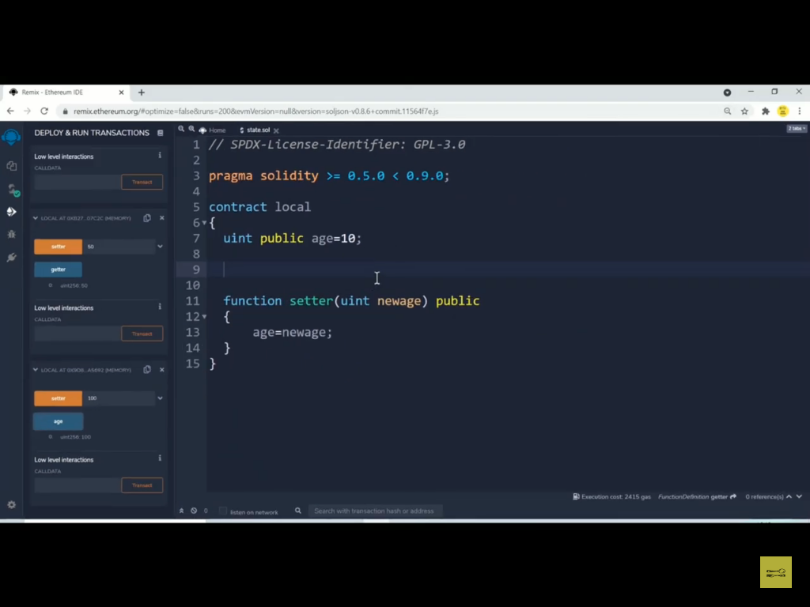

Slide 54
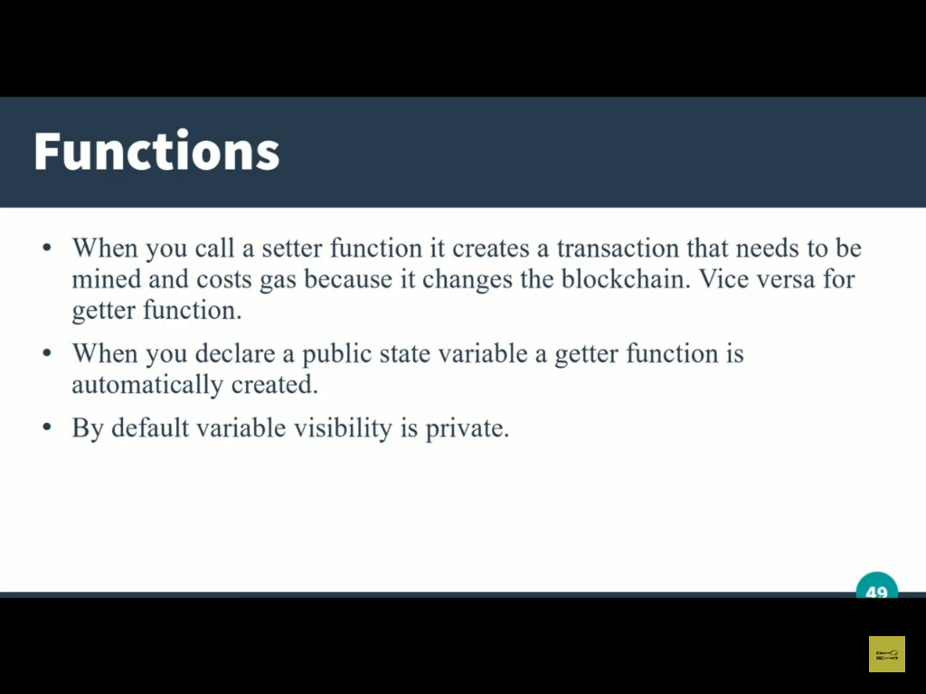

Slide 55
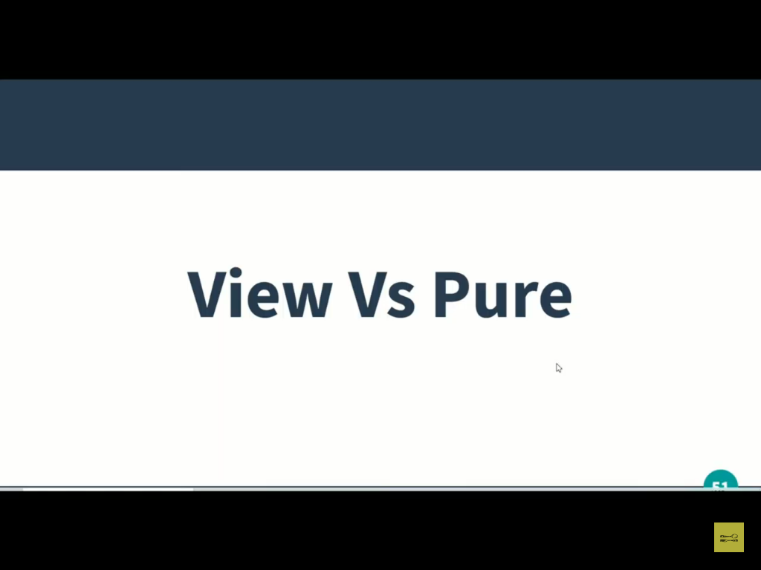

Slide 56
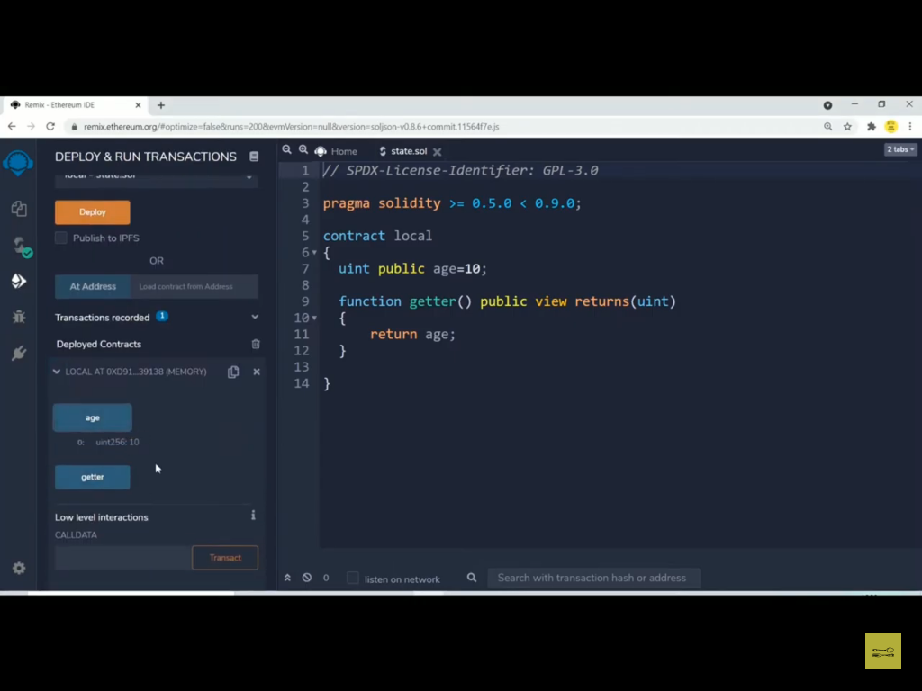

Slide 57
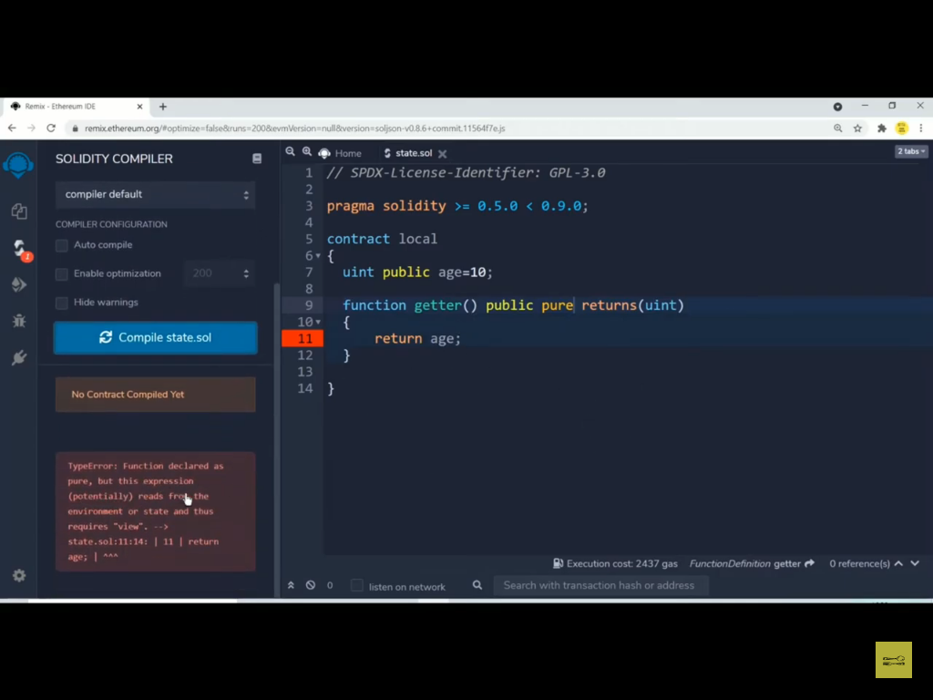

Slide 58


Slide 59


Slide 60


Slide 61
If you use pure you can not read or modify the state variable but local variable can be.
If you use view you can only read the content of the state variable.
If you are not modifying or reading the state variable then the compiler will show warning that either you can use view or pure.

Slide 62


Slide 63
Constructor can be used to initialize the state variable and to decide the owner of the contract.
Constructor is executed for only one time at the time of deployment of the contract.

Slide 64


Slide 65


Slide 66


Slide 67


Slide 68


Slide 69


Slide 70


Slide 71


Slide 72


Slide 73


Slide 74


Slide 75


Slide 76


Slide 77


Slide 78


Slide 79


Slide 80
Overflow in solidity
In 2018 Due to overflow problem large amount of ethers has been transferred without accounting it.
To overcome the problem of overflow previously safemath library was used .
But in new version of solidity like 0.8.0 this problem has been completely removed.

Slide 81


Slide 82


Slide 83


Slide 84


Slide 85


Slide 86


Slide 87


Slide 88


Slide 89


Slide 90


Slide 91


Slide 92


Slide 93


Slide 94


Slide 95


Slide 96


Slide 97


Slide 98


Slide 99


Slide 100


Slide 101


Slide 102


Slide 103


Slide 104


Slide 105


Slide 106


Slide 107


Slide 108


Slide 109


Slide 110


Slide 111


Slide 112


Slide 113


Slide 114


Slide 115


Slide 116


Slide 117


Slide 118


Slide 119


Slide 120


Slide 121


Slide 122


Slide 123


Slide 124


Slide 125


Slide 126


Slide 127


Slide 128


Slide 129


Slide 130


Slide 131


Slide 132


Slide 133


Slide 134


Slide 135


Slide 136
Contract Balance Update ….Payable

